Slide 1
Predicting Abnormal Grid Conditions
Will Coughlin wcoughlin@gatech.edu

Slide 2
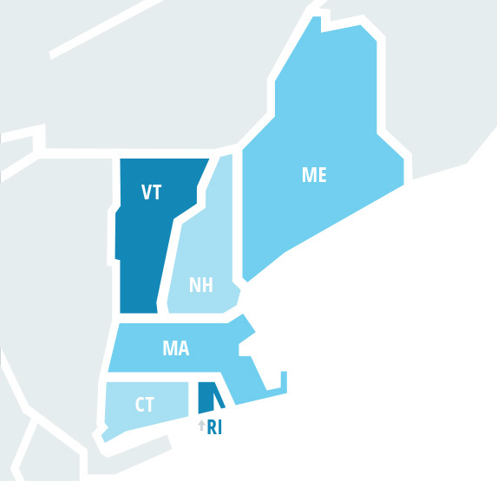
The New England Electric Grid
ISO New England (ISO-NE) is the sole transmission operator for the electric grid in the New England Region of the United States
ISO-NE ensures the reliability of the electric power system—overseeing day-to-day markets, and short to long-term planning.
Abnormal Grid Conditions
ISO-NE has several abnormal statuses that may be declared based on anticipated or current grid operation criteria.
These may include, but are not limited to:
OP4 Action 1: Power Caution
OP4 Action 4: Power Watch
Minimum Generation Emergency
A full description of each system status is available on the ISO-NE website.
The ISO-NE market area
Source: ISO-NE - Key Grid and Market Stats

Slide 3
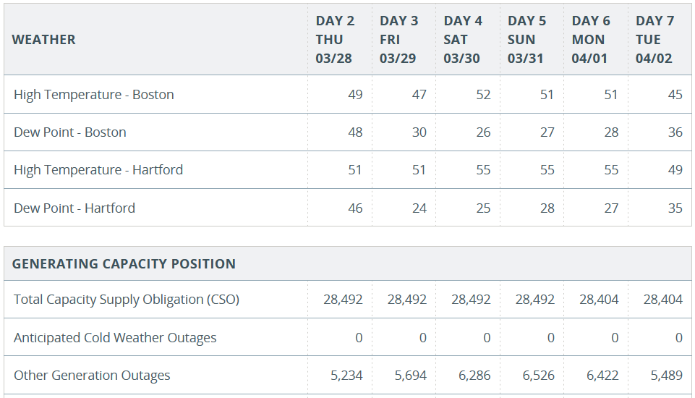
Capacity Forecasts
ISO-NE publishes daily system forecasts for their region.
These include temperature data, generation capacity and load projections.
Forecast values for one to six days ahead are available for each observed date.
A sample forecast table for March 28 to April 2, 2024
Source: ISO-NE – Seven-Day Capacity Forecast

Slide 4
Objectives
Using ISO-NE’s public data sources, is it possible to:
Build a binary classifier to accurately predict the occurrence of abnormal grid conditions using these weather and power system forecasts; and
Determine which factors most influence the declaration of abnormal grid conditions?

Slide 5
Data Sources and Processing
Two published datasets are of interest:
Power System Status Archive
Seven Day Capacity Forecast Archive
Using Python scripts and common data libraries:
Data from the two historic archives are pulled from year 2017 through 2023.
Data are reshaped and joined to create a unified dataset combining forecasts and declared statuses for each day.
Cleaning and reduction performed:
Combining all statuses into a single binary indicator of any abnormal condition.
Dropping 6 rows with many missing values for a specific date.
Dropping first 5 rows to account for lag values.
Removing attributes with no variance
Step | Produced
Web Scraping | 2556 daily forecast files, 7 annual grid status files
Transformation | 2556 daily rows, 116 attributes
Cleaning and Reduction | 2545 daily rows, 1 binary response, 102 numeric features

Slide 6
Data Attributes
Column Name | Type | Description
Abnormal | Binary | One or more abnormal statuses declared (0/1)
ACWO_1 | Numeric | Anticipated cold weather outages (MW)
ADMO_1 | Numeric | Anticipated de-list offered (MW)
ADRR_1 | Numeric | Available demand response (MW)
CSO_1 | Numeric | Total capacity supply obligation (MW)
DPB_1 | Numeric | Dew point in Boston (°F)
DPH_1 | Numeric | Dew point in Hartford (°F)
HTB_1 | Numeric | High temperature in Boston (°F)
HTH_1 | Numeric | High temperature in Hartford (°F)
Column Name | Type | Description
ITP_1 | Numeric | Import at time of peak (MW)
OGO_1 | Numeric | Other Generation outages (MW)
PPL_1 | Numeric | Predicted peak load (MW)
PS_1 | Numeric | Projected surplus/deficiency (MW)
RRIR_1 | Numeric | Required reserve including replacement (MW)
RRR_1 | Numeric | Replacement reserve requirement (MW)
TAGI_1 | Numeric | Total available generation and imports (MW)
TGA_1 | Numeric | Total generation available (MW)
TLRR_1 | Numeric | Total load plus required reserve (MW)
Note: Columns ending in “_1” are the one day-ahead values from the full dataset. The full dataset contains forecast values from one to six days ahead.

Slide 7
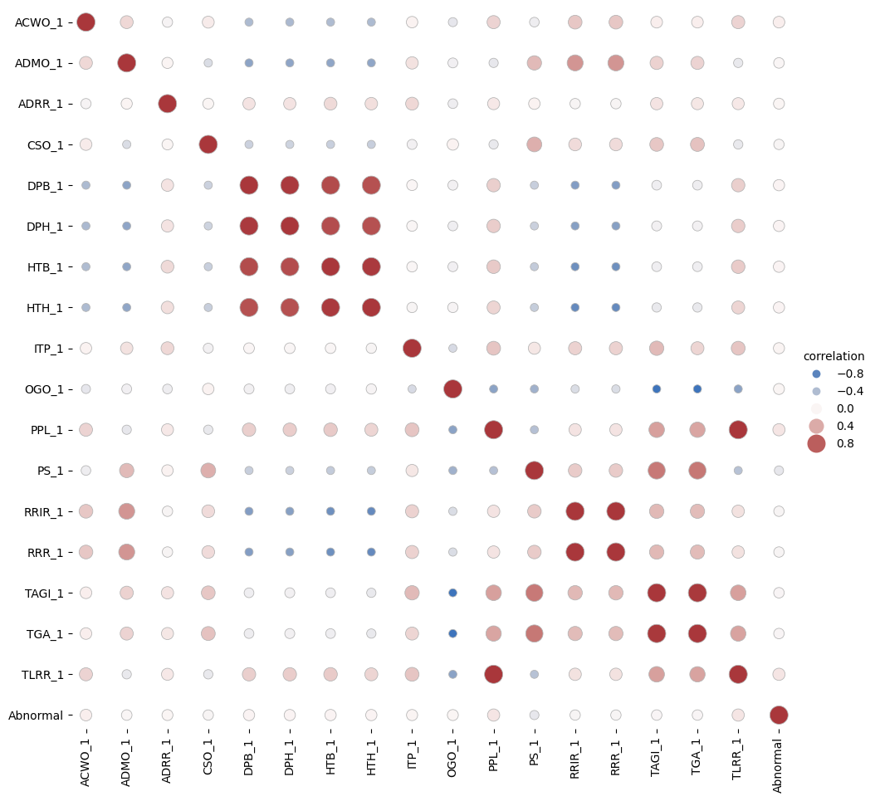
Feature Correlation
Several occurrences of high correlation:
High positive correlation identified with all Boston and Hartford temperature attributes.
High negative correlation between available generation and generation outages.
High correlation highlights redundant features.
Some features are sums or differences of others.
E.g., RRIR_1 = RRR_1 + RR_1

Slide 8
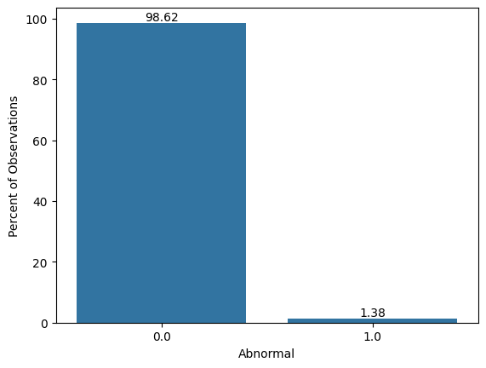
Occurrence of Abnormal Conditions
Abnormal Statuses | Count
Only ACON | 31
Only MGEN | 1
ACON, OP41, and OP42 | 1
ACON, OP41, OP42, OP43, and OP45 | 1
ACON and all OP4* | 1
ACON – Abnormal Conditions Alert/Reliability Warning
MGEN – Minimum Generation Warning
OP41 – Power Caution
OP42 – Energy Emergency Alert
OP43 – Voluntary Load Curtailment
OP44 – Power Watch
OP45 – Emergency Energy Purchasing
Definitions of these statuses are available from ISO-NE.
Significant challenges exist with imbalance of abnormal status. Out of 2545 rows, only 35 (1.38%) occurrences of one or more abnormal statuses.

Slide 9
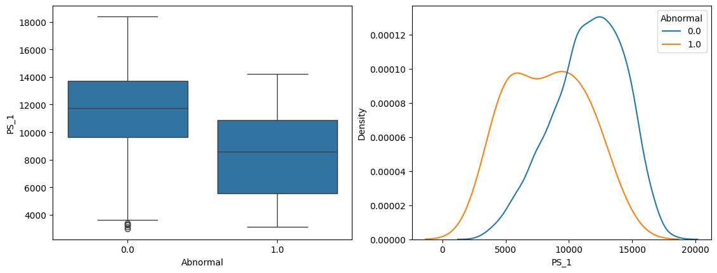
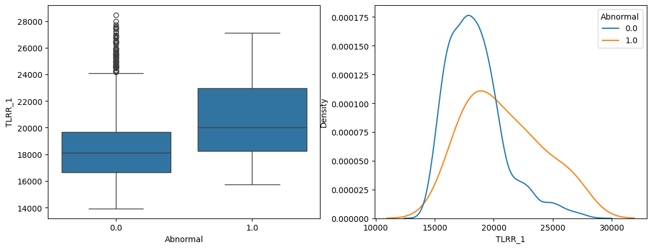
EDA Takeaways
There is a need to account for class imbalance in the response.
E.g., class weights, over-sampling (SMOTE)
There are several combinations of highly correlated or redundant features that may contribute to multicollinearity or other issues.
E.g., Temperatures in Boston vs. Hartford
Some predictors are identifiable as significantly related to the response by ANOVA test with relaxed assumptions:
E.g., TLRR_1 (Total Load plus Required Reserve), PS_1 (Predicted Surplus/Deficit)

Slide 10
Methodology
Logistic Regression Minority Class Resampling – SMOTE resampling to account for extreme imbalance.
Feature Selection - Correlation and cluster-distance-based elimination to eliminate redundant and highly correlated features.
Dimensionality Reduction – PCA
Classification Methods – Predict a binary response denoting the declaration of any abnormal status. Full, reduced, PCA variants compared for:
Logistic Regression
Support Vector Machine
k-Nearest Neighbors
Gradient Boosted Tree
Cross-validation – Hyper-parameter tuning with Stratified k-Fold.
Evaluation – Diagnostics to minimize false negatives:
Precision, Recall, F2 Score
Confusion Matrix

Slide 11
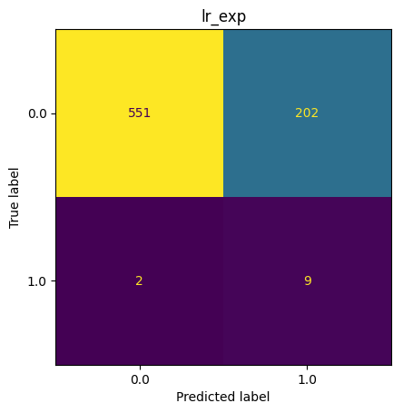
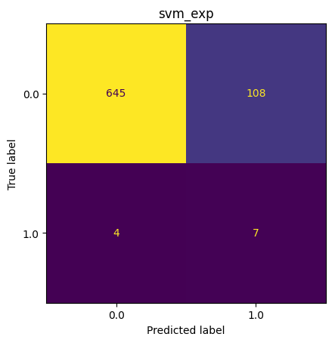

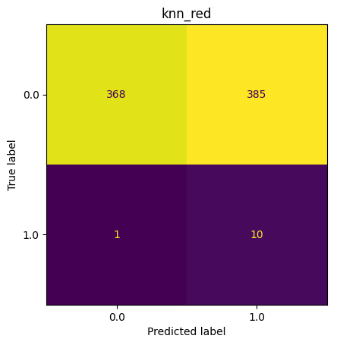
Results: Confusion Matrices
Test set prediction confusion matrices for the best model of each type:
Logistic Regression (with previous 6 forecasts)
SVM (with previous 6 forecasts)
KNN (day-ahead forecast, reduced features)
Gradient Boosted Tree (with previous 6 forecasts)
Clockwise, from top left: Logistic Regression, SVM, KNN, Gradient Boosted Tree.

Slide 12
Results: Metrics
Model | Precision | Recall | F2 | AUC
Gradient Boosted Tree (w/ prev. 6 forecasts) | 0.06 | 0.64 | 0.23 | 0.82
SVM (w/ prev. 6 forecasts) | 0.06 | 0.64 | 0.22 | 0.88
Logistic Regression (w/ prev. 6 forecasts) | 0.04 | 0.82 | 0.18 | 0.86
KNN (w/ day-ahead forecast, reduced features) | 0.03 | 0.91 | 0.11 | 0.70
Precision, recall, F2, and AUC values for the best model of each type.
Results ordered by descending F2 score.

Slide 13
Findings and Conclusions
Support Vector Machine (SVM) and Gradient Boosted Tree (GBT) correctly classified 7 out of 11 instances of abnormal grid conditions in the test set, while almost halving the rate of false negatives compared to the next best method (Logistic Regression).
In general:
Logistic regression and SVM worked quite well out of the box.
KNN and GBT required more effort in tuning hyper-parameters.
No classification methods were found to benefit from PCA.
Class imbalance and small number of positives in the test set result in large fluctuations in metrics.
Projected peak load and anticipated cold-weather outages are among the strongest predictors of abnormal grid conditions in the SVM and GBT models. Some features are more influential only within the two models:
SVM weights Boston high temperature values fairly high in its decision-making.
GBT experiences more information gain from projected surplus than does SVM.

Slide 14
Future Work
ISO-NE provides many more years of historic data in unstructured format. Provided that this data could be extracted and structured, more data could improve model quality.
Alternative techniques could be explored for:
Handling class imbalance. E.g., class weighting, under sampling.
Feature selection to reduce noise/overfitting. E.g., AIC, BIC, GINI importance, mutual information.
Response distribution and predicting individual grid statuses as multinomial.

